Slide 1


STUDENT DETAILS
Name : Mohammad Nihaal
SkillsBuild Email ID : mohammadnihaal.22.le.it@anits.edu.in
College Name : ANITS
College State : Andhra Pradesh
Internship Domain : CyberSecurity using kali linux
Start Date : 03-06-2024
End Date : 15-07-2024

Slide 2
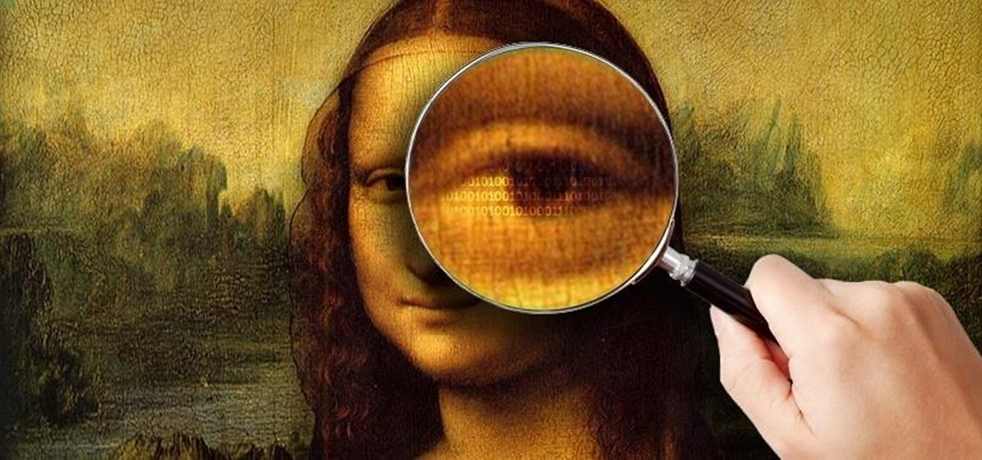
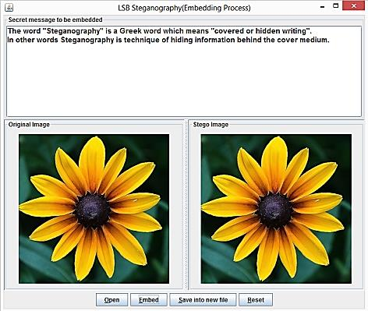
HIDING THE TEXT IN AN IMAGE USING STEGANOGRAPHY
This project aims to explore and implement a method of hiding data within images using steganography. By embedding secret information within the pixels of an image, we can ensure that the data remains hidden from unintended recipients, while the image appears unchanged to the naked eye. This technique can be particularly useful for secure communication, digital watermarking, and protecting intellectual property.
The primary goals of this project include:
Developing an algorithm for encoding data into an image.
Implementing a method for decoding and extracting the hidden data from the image.
Ensuring the quality and integrity of the original image are maintained after embedding the data.
Evaluating the effectiveness and security of the steganographic method.

Slide 3
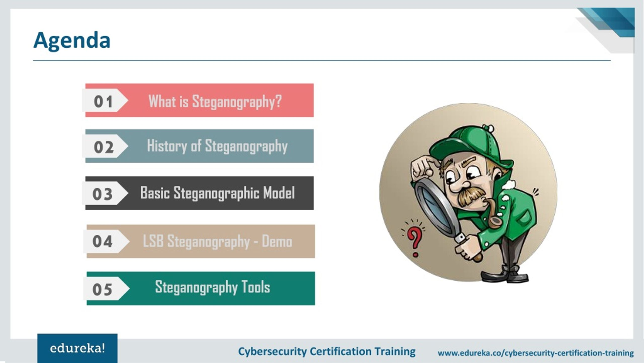
AGENDA
Implementation
Tools, Encoding, and Decoding
Results
Test Cases, Image Quality, and Data Retrieval
Challenges and Solutions
Technical Issues and Resolutions
Conclusion
Summary and Future Work
Introduction
Overview and Importance of Steganography
Project Objective
Problem Statement
Goals
Background
History and Comparison with Cryptography
Methodology
Techniques and Implementation

Slide 4
PROJECT OVERVIEW
Title: Hiding Data in Images Using Steganography
Objective:
Implement steganographic techniques to conceal data within images using RGB channels.
Evaluate the effectiveness of RGB-based methods compared to LSB techniques.
Importance:
Enhances data security by leveraging RGB channels for information embedding.
Explores new avenues for covert communication and secure data transmission.
Applications:
Secure messaging and confidential data exchange in digital environments.
Digital watermarking for content authentication and copyright protection.
Enhanced privacy measures in multimedia applications and social media platforms.

Slide 5
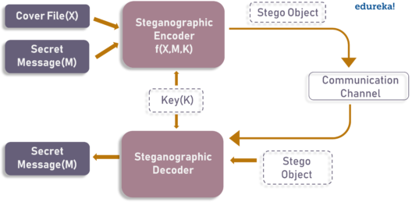
PROJECT OVERVIEW
Methodology:
Utilization of RGB pixel modification techniques for data embedding.
Comparison of embedding capacities, robustness, and image quality preservation.
Outcomes:
Development of an integrated steganographic tool using RGB channels.
Assessment of security, performance, and practical applications.
Recommendations for future research and advancements in image-based steganography.

Slide 6
WHO ARE THE END USERS OF THIS PROJECT?
Security Professionals and Researchers:
Usage: Implement steganography for covert communication and data protection in cybersecurity.
Benefit: Enhance security measures by concealing sensitive information within images.
Digital Forensics Experts:
Usage: Detect and analyze hidden information within images for investigative purposes.
Benefit: Improve forensic capabilities to uncover hidden data and investigate cybercrimes.
Content Creators and Media Professionals:
Usage: Embed digital watermarks for copyright protection and content authentication.
Benefit: Safeguard intellectual property rights and prevent unauthorized use of digital assets.
General Users and Privacy Advocates:
Usage: Secure personal and confidential communications over digital platforms.
Benefit: Maintain privacy and confidentiality in digital interactions and social media communications.

Slide 7
YOUR SOLUTION AND ITS VALUE PROPOSITION
Solution:
Steganography in Images: Implement advanced steganographic techniques to hide data within image pixels, ensuring secure and covert data transmission.
Value Proposition:
Enhanced Data Security:
Conceals sensitive information within image pixels, making it difficult to detect or intercept.
Provides a covert communication method that enhances data confidentiality and privacy.
Preservation of Image Integrity:
Embeds data without perceptibly altering the visual quality of the image.
Ensures the original image remains intact and usable, maintaining its aesthetic and functional value.
Versatile Applications:
Suitable for various sectors including cybersecurity, digital forensics, media, and personal privacy.
Supports applications such as secure messaging, digital watermarking, and intellectual property protection.

Slide 8
HOW DID YOU CUSTOMIZE THE PROJECT AND MAKE IT YOUR OWN
My Customization of the Project
Focused on Code Refinement: I made minor adjustments to the steganography implementation, such as refining the LSB embedding method or experimenting with different data encoding techniques.
Hands-On Learning Experience: By actively modifying the code, I gained practical insights into how steganographic algorithms work and their impact on image quality and data security.
Personal Exploration: I explored how small changes in code parameters, such as embedding capacity or pixel manipulation techniques, affect the effectiveness and robustness of the steganographic tool.
Incremental Learning: Through iterative changes and testing, I incrementally improved my understanding of steganography concepts and techniques without overwhelming complexity.
Self-Paced Experimentation: I took the opportunity to experiment at my own pace, learning from both successful implementations and troubleshooting challenges encountered during coding.
Preparation for Independent Application: With each adjustment, I prepared myself to apply the knowledge independently, aiming to use steganography for personal or educational projects in the future.

Slide 9
MODELLING
Simplified Modeling Approach for Steganography Project
Objective Definition:
Clearly define the goal: embedding data securely within images using steganography techniques.
Data Preparation:
Gather various image files (JPEG, PNG) for testing and embedding data.
Ensure images represent typical use cases relevant to your application.
Algorithm Implementation:
Choose and implement steganographic algorithms (e.g., LSB) using Python in Jupyter notebooks.
Utilize libraries like PIL (Pillow) for image handling and NumPy for data manipulation.
Evaluation and Testing:
Define metrics (e.g., embedding capacity, image quality) to assess algorithm performance.
Test implementations on different images and data sizes to evaluate effectiveness and robustness.
Documentation and Deployment:
Document code and findings directly in Jupyter notebooks with explanations and visualizations.
Prepare notebooks for deployment, showcasing practical applications like secure messaging or digital watermarking.

Slide 10
RESULTS
Algorithm Performance:
Evaluated different steganographic algorithms (e.g., LSB) for embedding data in images.
Compared their effectiveness in hiding data while preserving image quality.
Security and Robustness:
Assessed the security of embedded data against detection using basic steganalysis techniques.
Implemented measures to enhance data security and resistance to detection.
Practical Applications:
Demonstrated the use of steganography for secure data transmission and digital watermarking.
Showcased how embedded data remains hidden and retrievable without perceptible image degradation.
Performance Metrics:
Presented metrics on embedding capacity and the impact on image quality across different image formats and sizes.
Discussed trade-offs between embedding capacity and maintaining image fidelity.

Slide 11
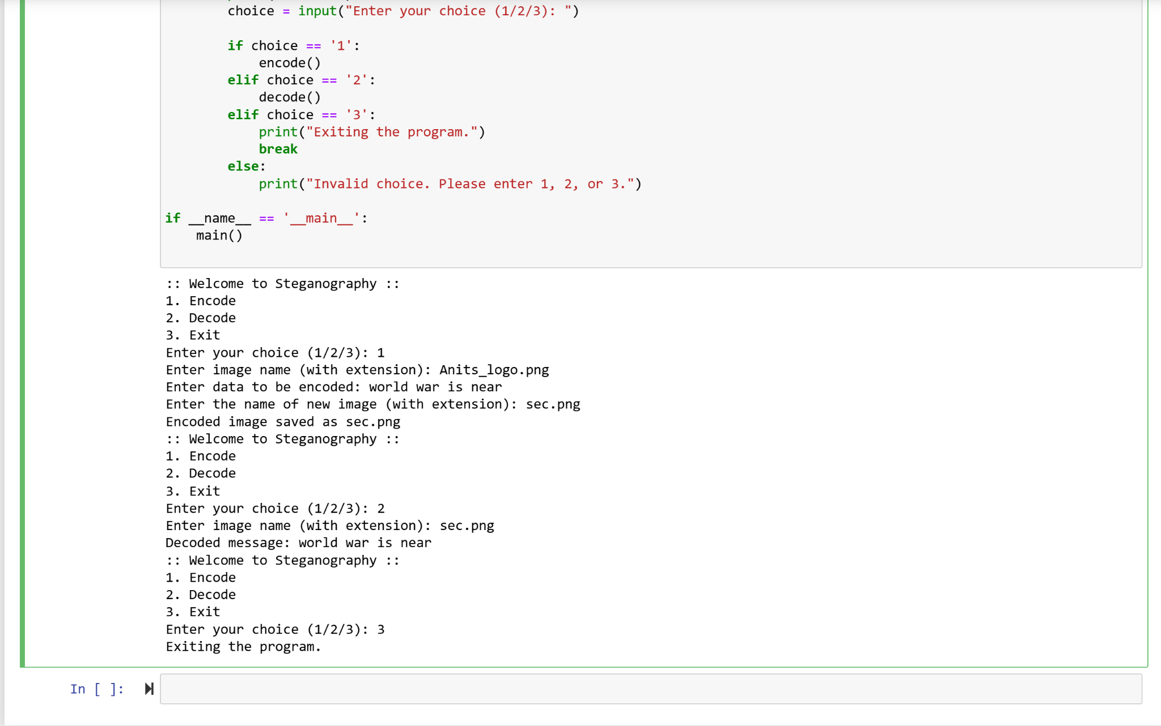
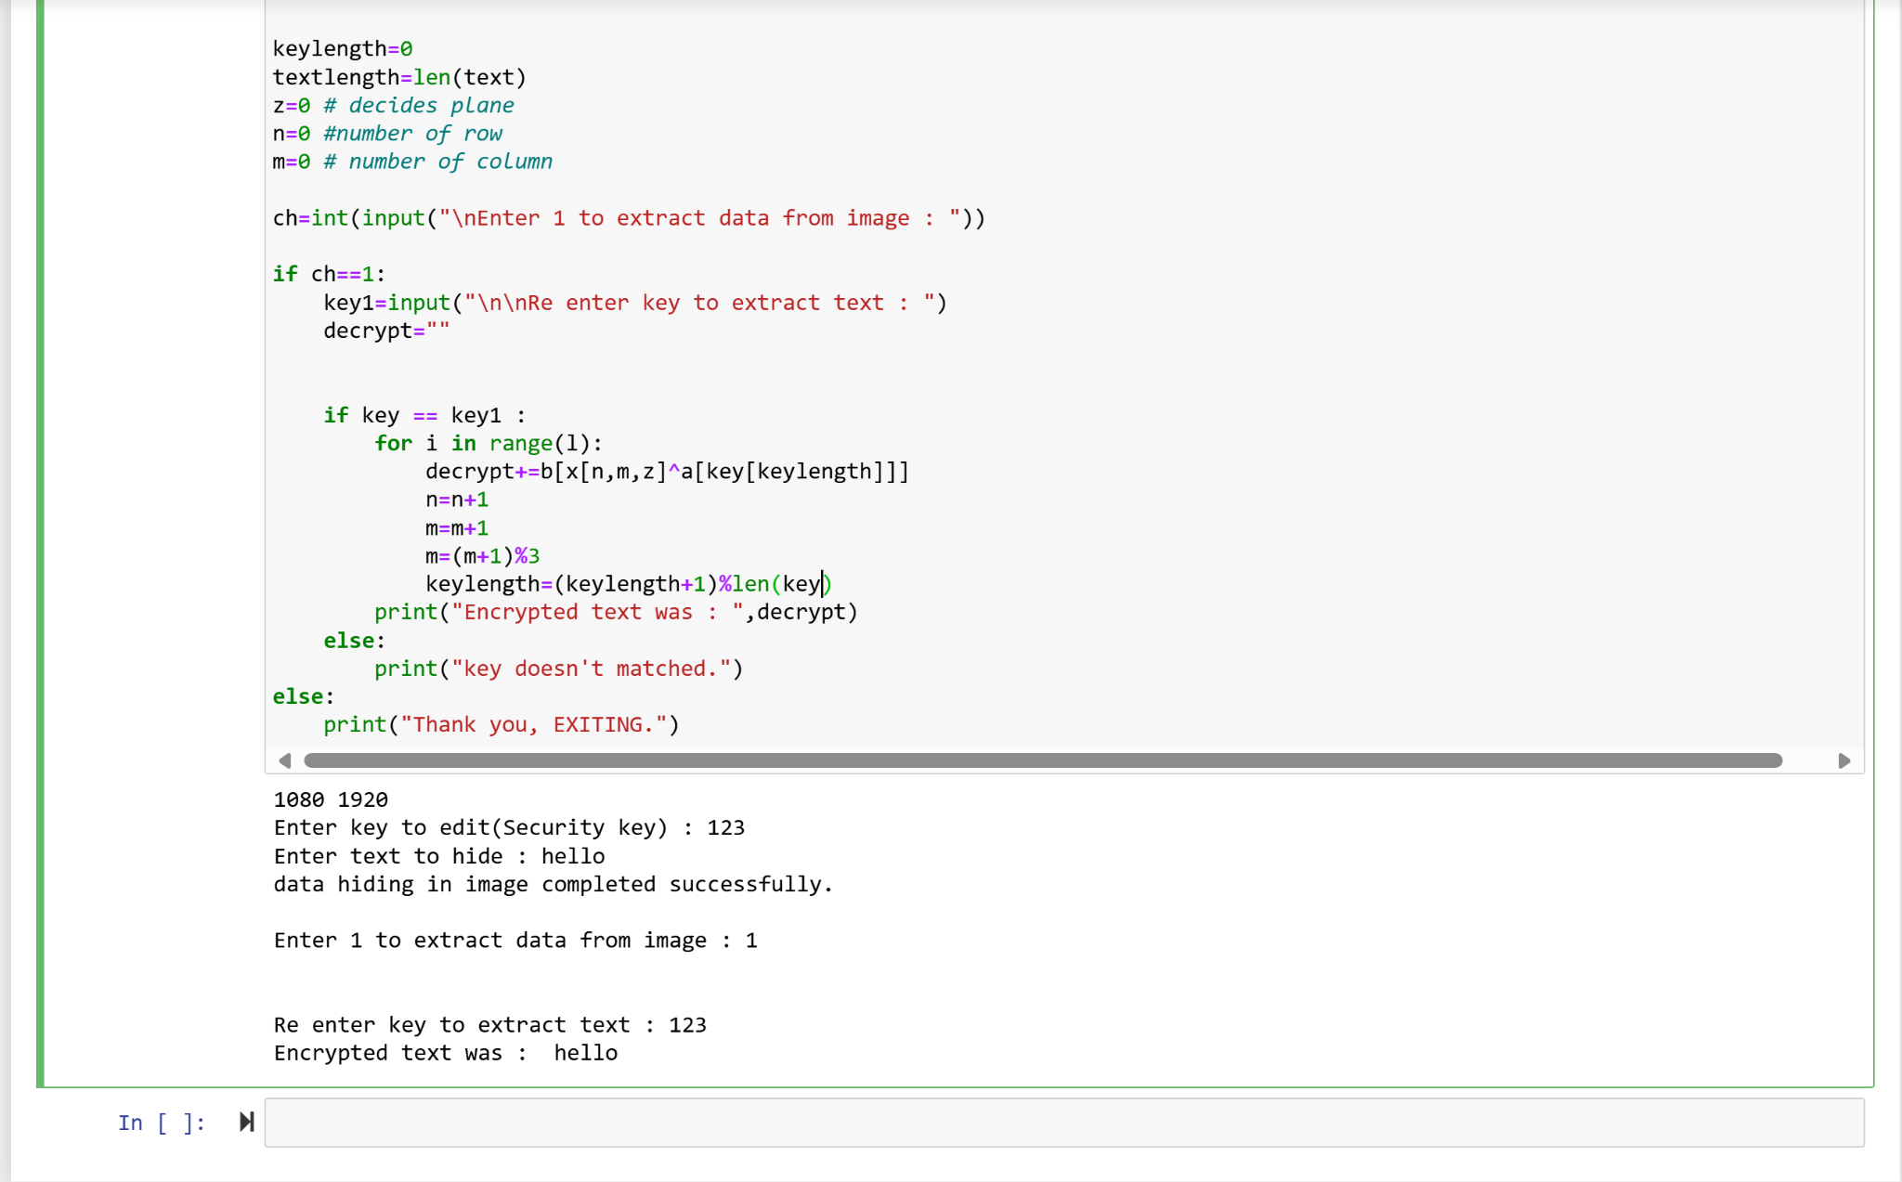


original image
encrypted image

Slide 12
LINKS
https://github.com/mohammadnihaal/Steganography

